Slide 1
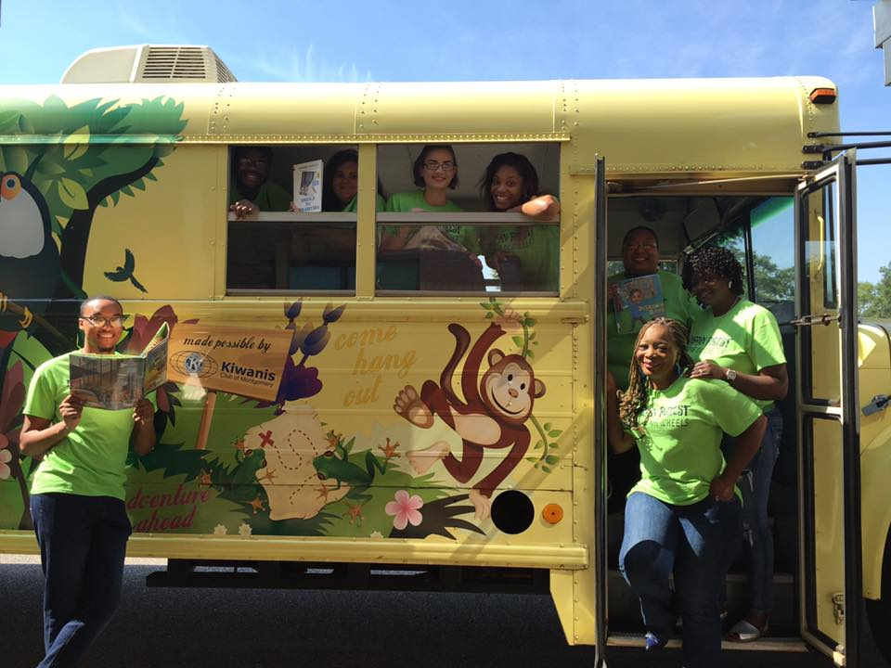
READING on WHEELS
2016 Report

Slide 2
2016 PROGRAM GOALS
Encourage culture of summer learning while decreasing the “summer slide”
Support literacy with ongoing access to a diverse collection
Engage students during the summer with intentional STEM instruction through hands-on, project-based activities
ROW by the Numbers:
2 Mobile Libraries
7 Staff Members
16 sites throughout Montgomery county
1,000 students ranging ages 6-16
7 weeks of highly engaged learners!

Slide 3
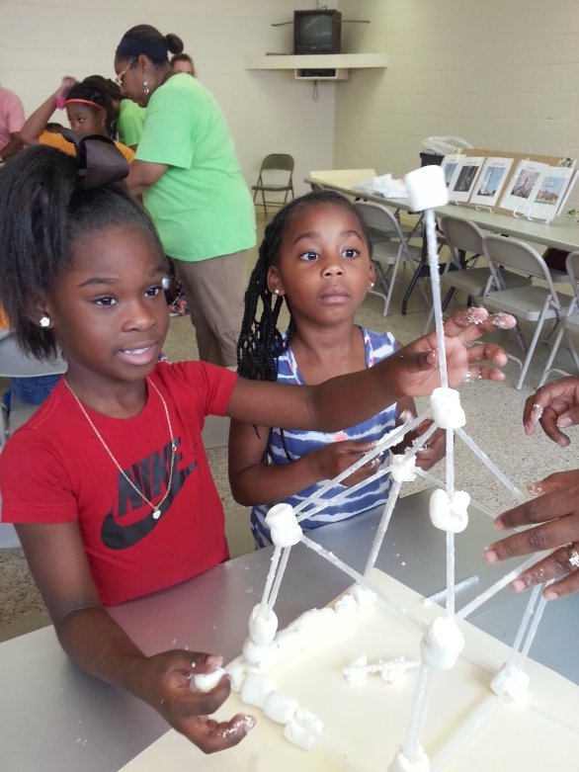
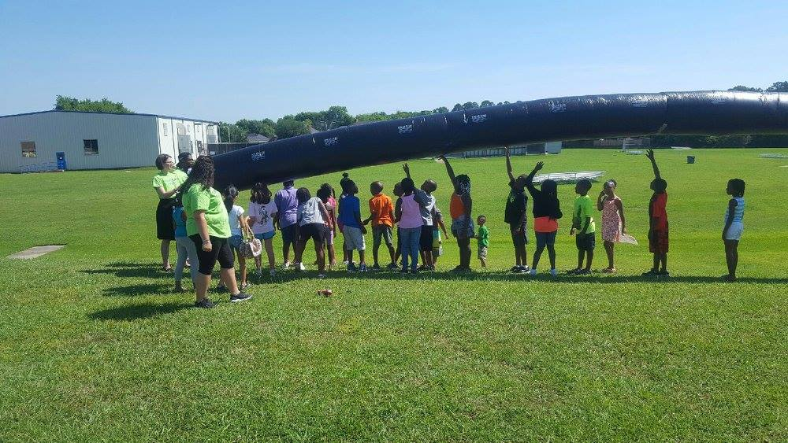
Curriculum Overview
Engineering
Forms of Energy: Electricity
Forms of Energy: Heat
Chemistry
Biosystems
Laws of Motions
Review Week

Slide 4
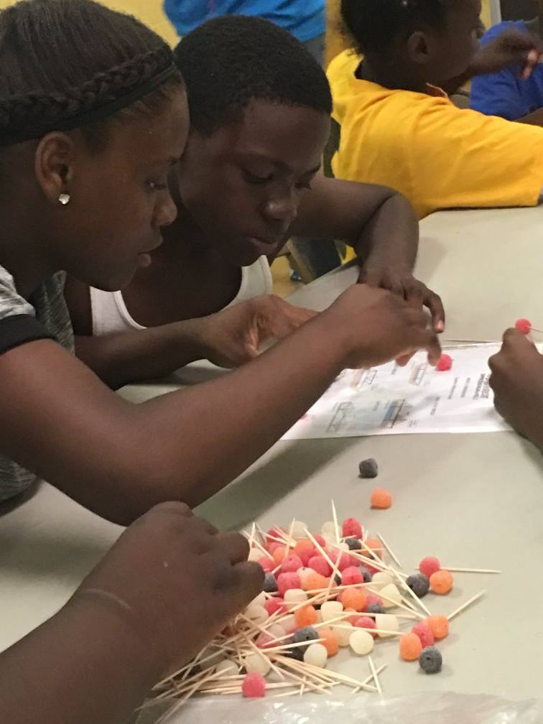
Visited Sites
Chisholm Boys & Girls Club
Cleveland Ave YMCA
Common Ground
Dunbar Ramer School
Flatwood CC
Floyd CC
First Baptist of Greater Washington Park
Goodtimes YMCA
Hayneville Rd. CC
Heritage Baptist Church
Highland Gardens CC
Kershaw YMCA
Shiloh AME (Hope Hull)
Sheridan Heights CC
Southeast YMCA
Willie Cook CC

Slide 5
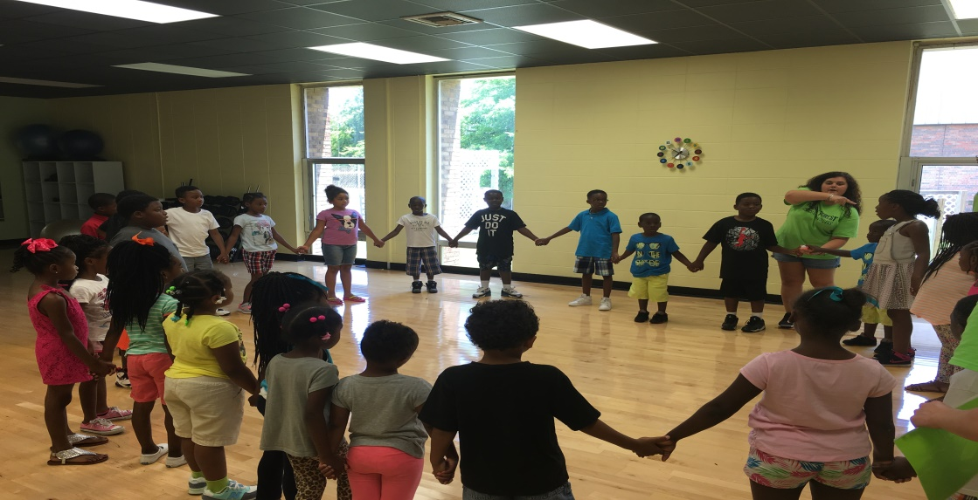
Partnerships:
Montgomery City-County Public Library (MCCPL) houses the ROW mobile library collection in addition to handling book cataloging, inventory, and assortment.
The Montgomery County Commission and the Montgomery Public Schools system provide ongoing support to ROW through funding, bus maintenance, and use of facilities.

Slide 6
Bookmobile Collection
Book donations from the Montgomery Education Foundation: 147 titles, 1,306 items
Books transferred from our Pine Level Library (now closed) to the bookmobile: 1,934
Total items added to bookmobile in 2016: 3,240

Slide 7
Data & results
Student Participation
Bus 1

Slide 8
Data & results
Student Participation
Bus 2

Slide 9
Data & results

Slide 10
Data & results
98% | Agreed that Reading on Wheels participants level of engagement was good or excellent
100% | Agreed that the quality of the Reading on Wheels staff interactions with participants was good or excellent
100% | Agreed that the Reading on Wheels staff’s level of professionalism was good or excellent
100% | Agreed that the quality of instruction from Reading on Wheels staff was good or excellent
100% | Agreed that their level of satisfaction with the Reading on Wheels STEM curriculum was good or excellent

Slide 11
Data & results

Slide 12
Data & results
If the ROW program did not visit how much time (hours) would students spend on reading?
Bus 1

Slide 13
Data & results
If the ROW program did not visit how much time (hours) would students spend on reading?
Bus 2

Slide 14
Data & results
If the ROW program did not visit how much time (hours) would students spend on STEM?
Bus 1

Slide 15
Data & results
If the ROW program did not visit how much time (hours) would students spend on STEM?
Bus 2

Slide 16
Recommendations
Hiring
Recruit staff members with emphasis in STEM
Consider a delay in ROW staff hiring schedule
Structure
Revise program guidelines. Specified “qualifications” to serve as ROW site will be adopted (time allotted for program, ages of participants, no. of participants, etc.)
Incorporate intentional reading time with three age appropriate novels over the course of the summer
Implement additional tools for measurement and assessment of both literacy and STEM instruction
Register and input all participants prior to week 1 and no later than week 2 in MCCPL system in order to ensure access to mobile collection is maximized
Research similar mobile-based programs for additional structural considerations
Communications and Site Relationships
Prepare and confirm summer site schedule no later than May 12, 2017
Mandate pre-summer orientation meeting between ROW program director, staff, and site directors
Amend memorandum of understanding as an agreement between MEF and all staff directors in order to better communicate the parameters of the program, including necessary staff support for the program’s literacy component
Plan additional promotion and community outreach to showcase the program

Slide 17
Recommendations
Literacy
Expand collection to include more non-fiction texts
Increase focus on literacy component including devoted reading time and tracking/measurement of books being read
STEM
Specify weekly time for staff preparation ensured preparation for the following week’s instruction and enhanced program delivery
Develop curriculum with increased effectives of instructional delivery and execution
Assess student engagement and learning based on the curriculum was centered as a priority and will inform curriculum revisions and structural changes for 2017
Instruction
Consider rotation or tailored instruction for various age groups – to be determined prior to next summer’s launch
Target instruction to reinforce core concepts and using effective learning strategies to check for understanding from students
Reassess curriculum and best instructional strategies based on observations and input of ROW staff throughout the summer
Partnerships
Renew and create positive partnerships between MEF and community partners to enhance program quality and success

Slide 18
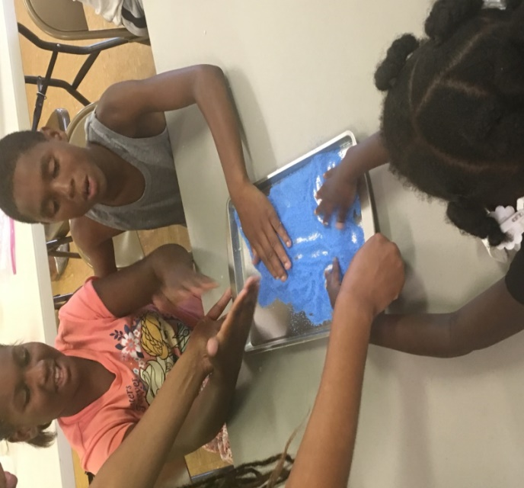
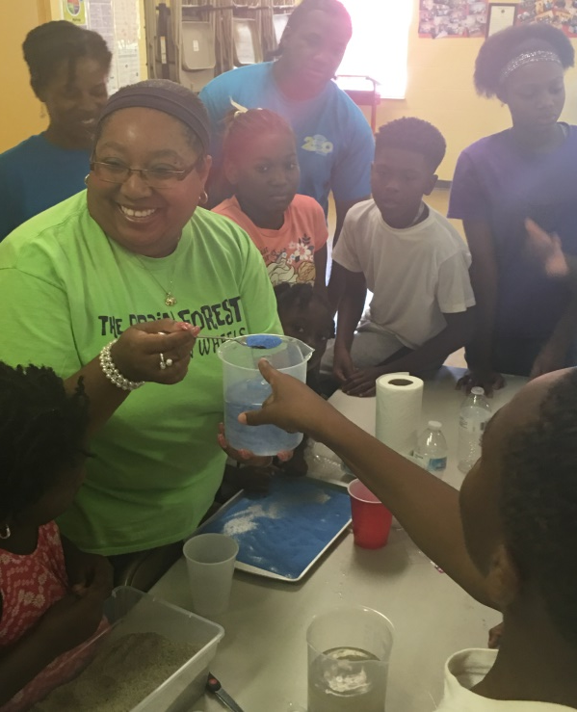
NEXT STOP:
READING ON WHEELS 2017

